Slide 1
Why AI (deep learning) now?

Slide 2
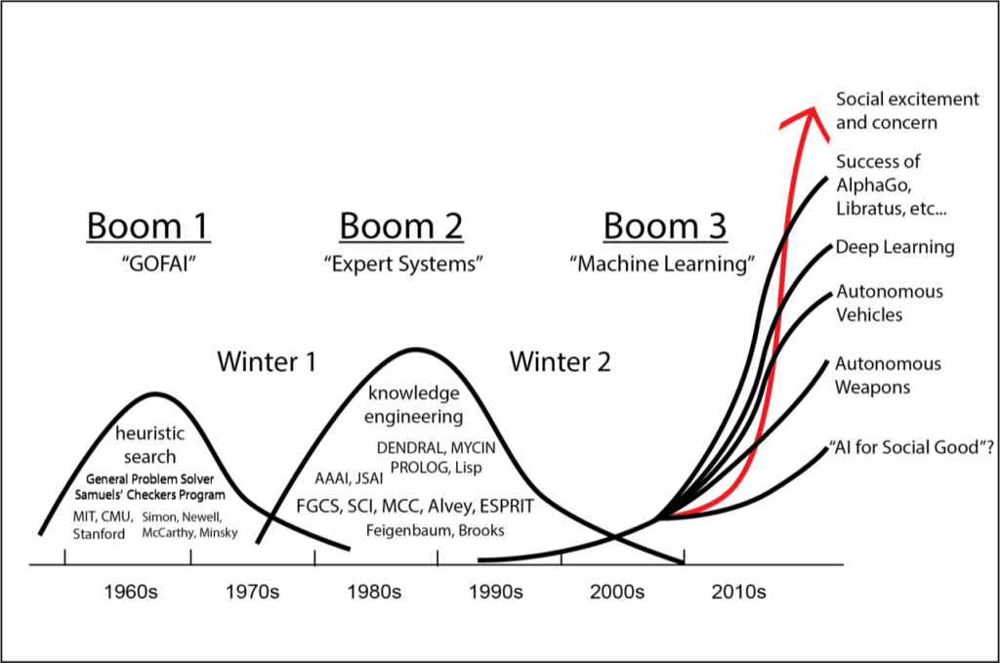
AI Booms
Credit to Colin Garvey, 2018

Slide 3
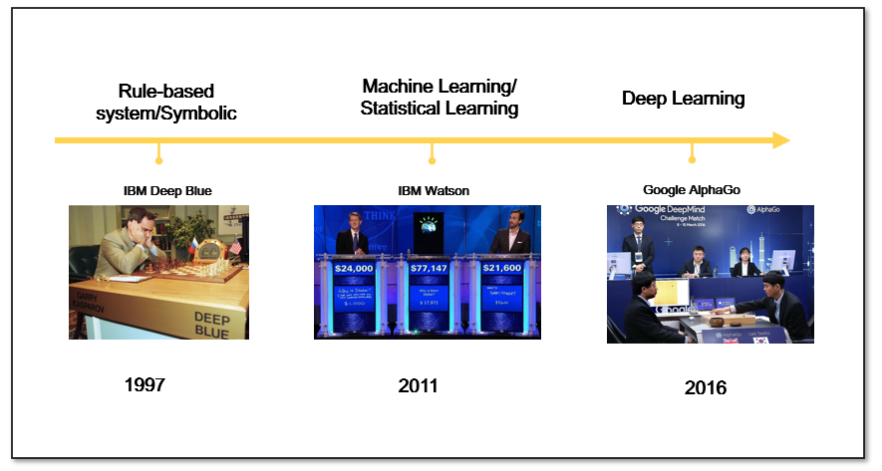
Different types of AI

Slide 4
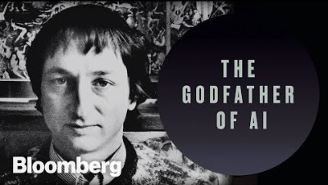

Slide 5

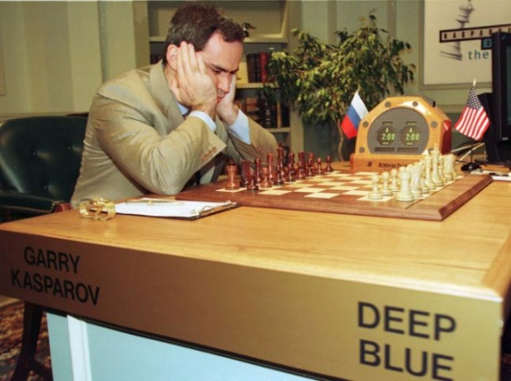
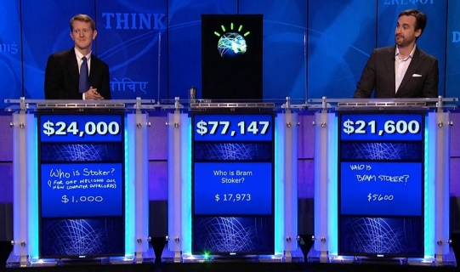
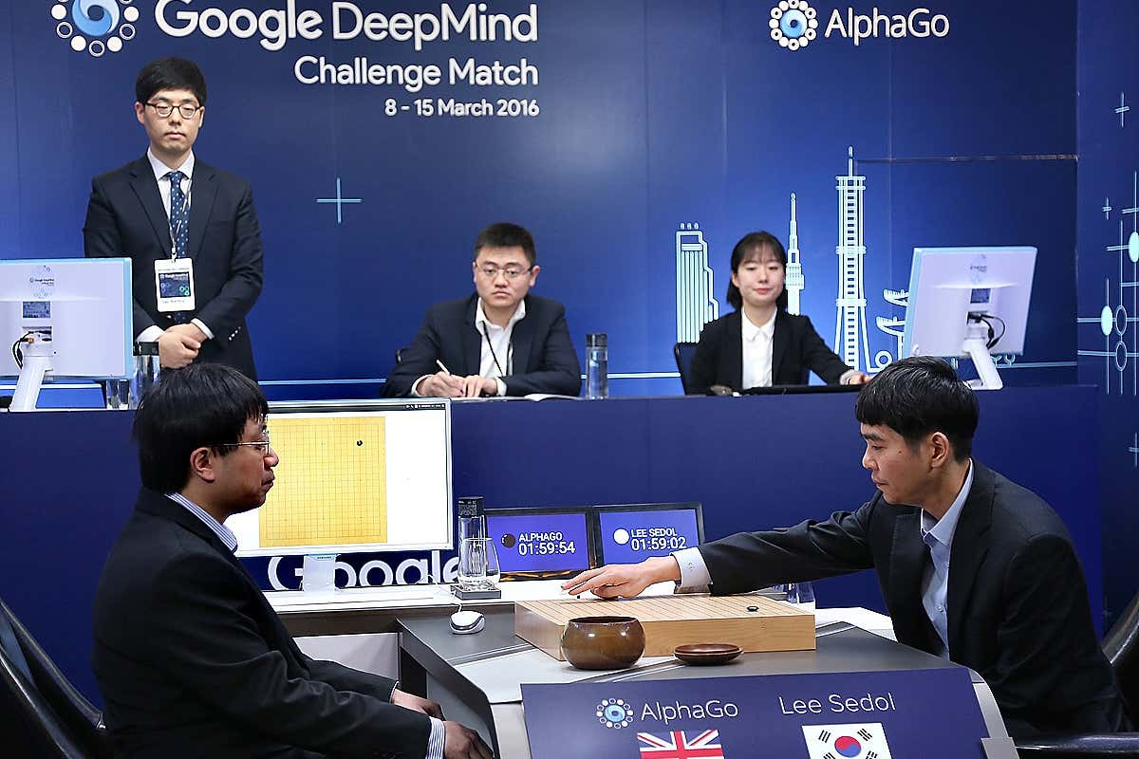



Three generations of AI
Rule-based system/Symbolic
Machine Learning/ Statistical Learning
Deep Learning
1997
2011
2016
IBM Deep Blue
IBM Watson
Google AlphaGo
1997
2011
2016

Slide 6
Why AI now (again)? Advances in Algorithm
Advances in algorithm
Advances in computing/hardware
Advances in Big Data

Slide 7
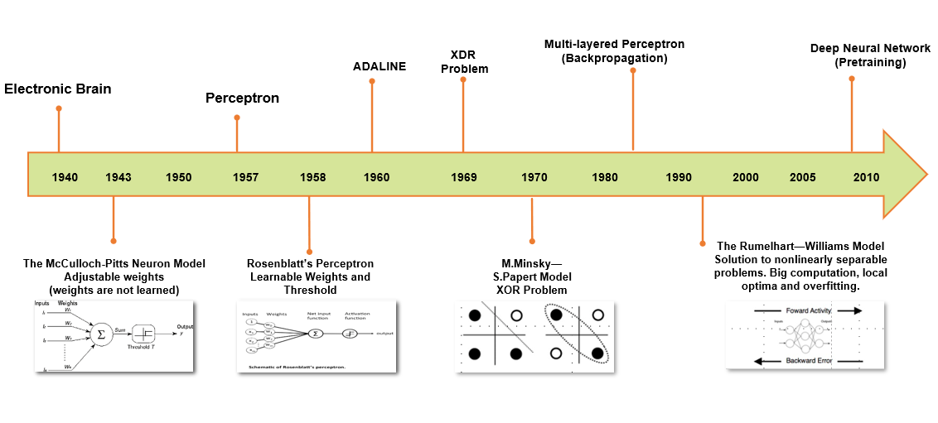
Algorithm Breakthroughs

Slide 8
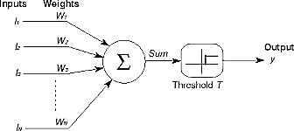
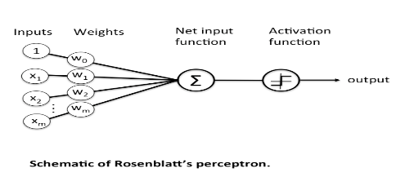
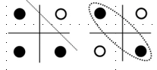
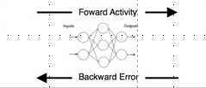
Algorithm breakthroughs
XDR
Problem
Multi-layered Perceptron
(Backpropagation)
Deep Neural Network
(Pretraining)
ADALINE
Electronic Brain
Perceptron
1940 1943 1950 1957 1958 1960 1969 1970 1980 1990 2000 2005 2010
The Rumelhart—Williams Model
Solution to nonlinearly separable problems. Big computation, local optima and overfitting.
The McCulloch-Pitts Neuron Model
Adjustable weights
(weights are not learned)
Rosenblatt’s Perceptron
Learnable Weights and Threshold
M.Minsky—S.Papert Model
XOR Problem

Slide 9



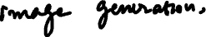
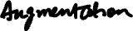
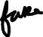
Turing Award in 2018
Critical Funding from Canada (CIFAR)
Geoffrey Hinton: Internalizing the learning and keep the momentum
Yoshua Bengio: Generative adversarial networks (GANs)
Yann LeCun: Early Convolutional Neural Network (CNN)
Notes:
Thank the Canadians.
Canadian Institute for Advanced Research

Slide 10
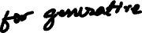
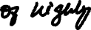


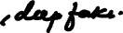
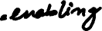
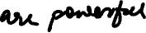
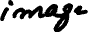
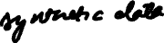
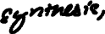

Slide 11

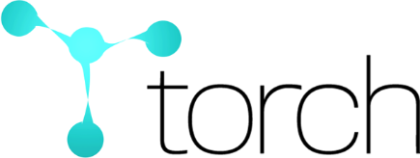




Modern Deep Learning Development
2010
2013
2016
2002
2011
2014
2017

Slide 12
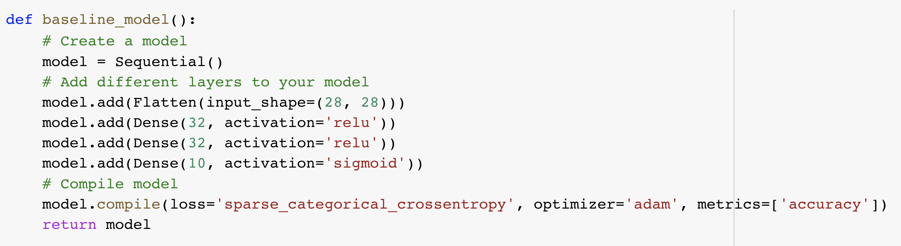
Build the Neural Network Using Keras

Slide 13
Why AI now? Advances in Computing Power
Advances in algorithm
Advances in computing power
Advances in Big Data

Slide 14
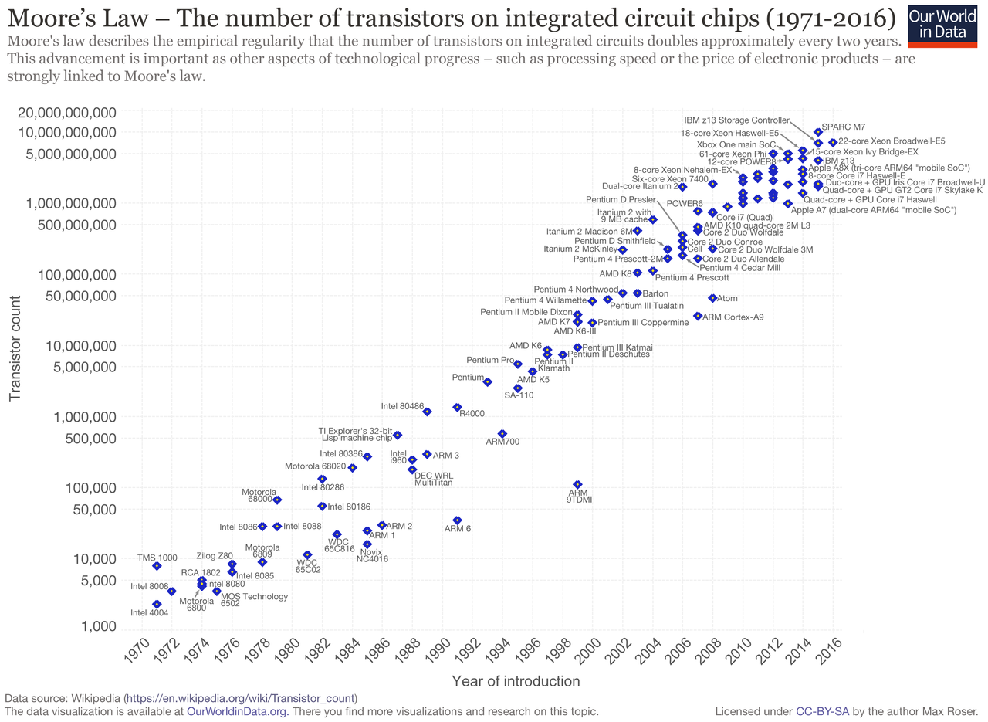
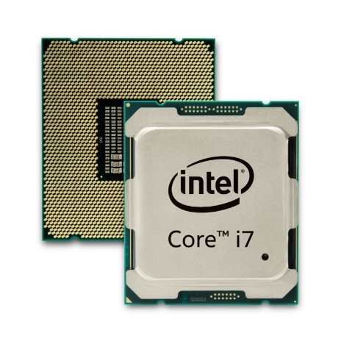
Computing power

Slide 15
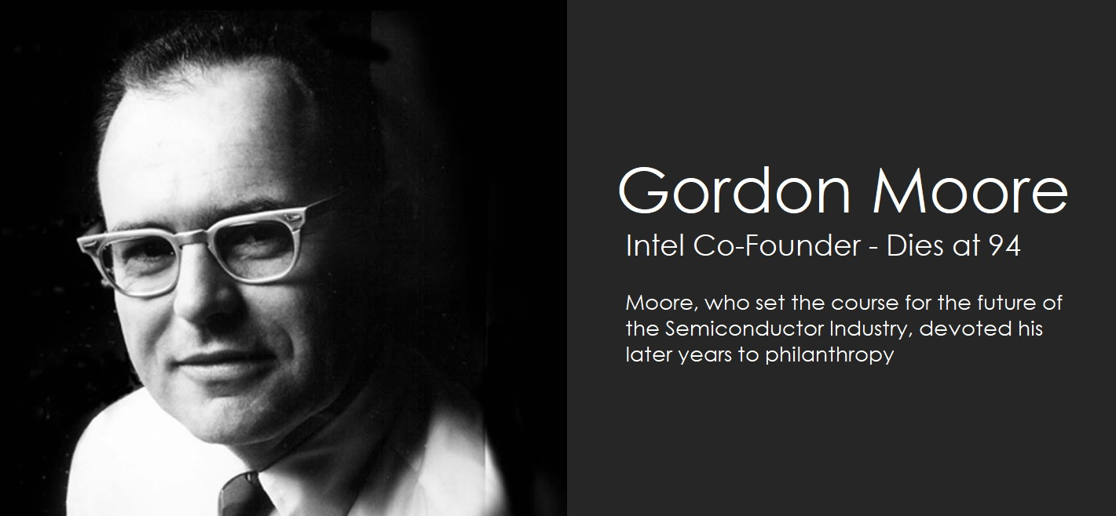

Slide 16
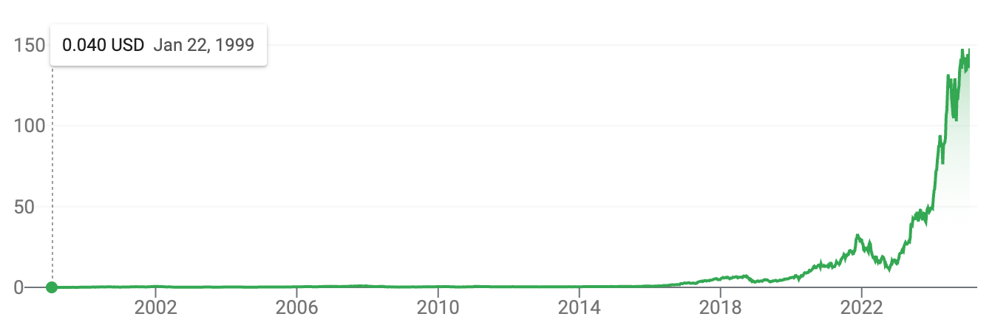

Slide 17
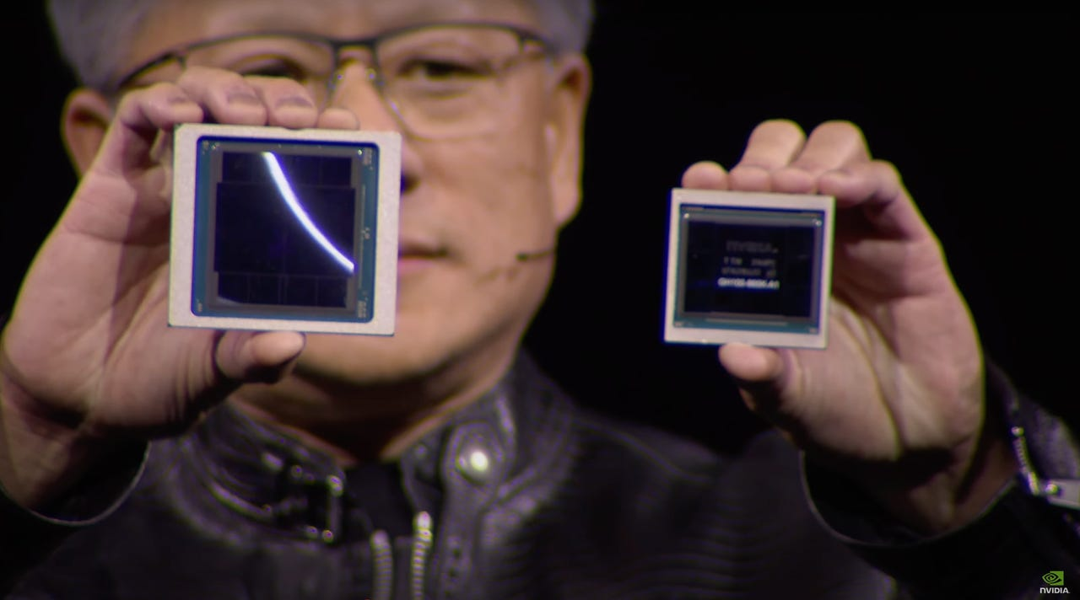
Notes:
Blackwell compared to H100. Blackwell can run large language models of generative AI with a trillion parameters 25 times faster than prior chips, Huang said.

Slide 18
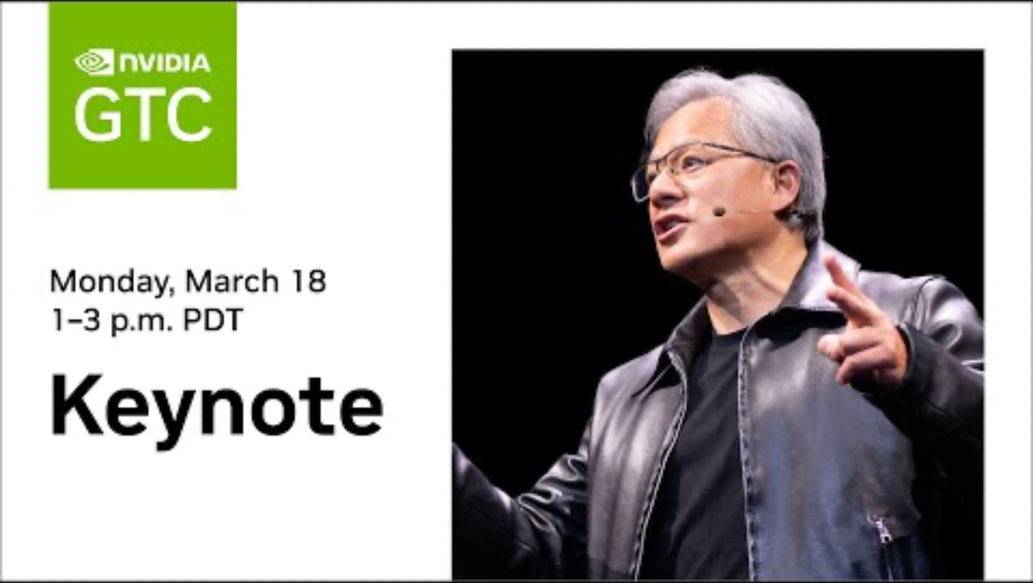

Slide 19
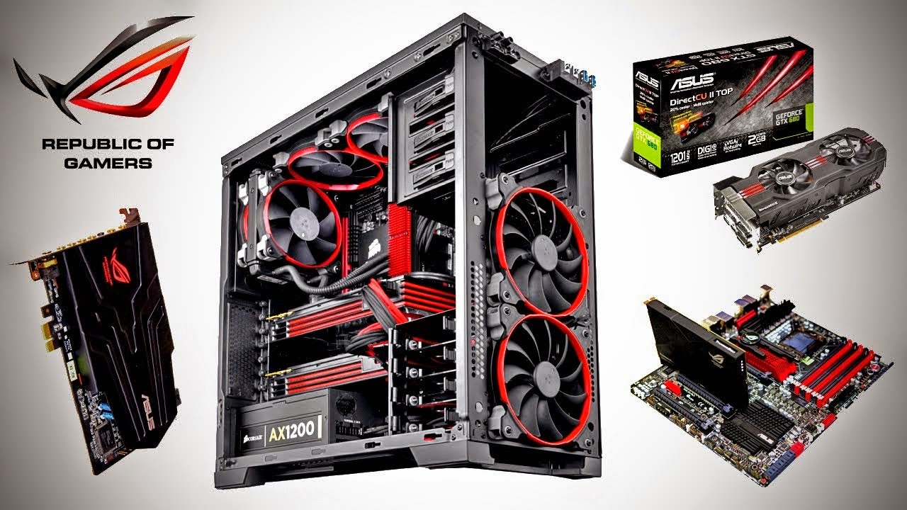
Video card computing power
Video card computing power - increased 1 million times since the 1990s

Slide 20
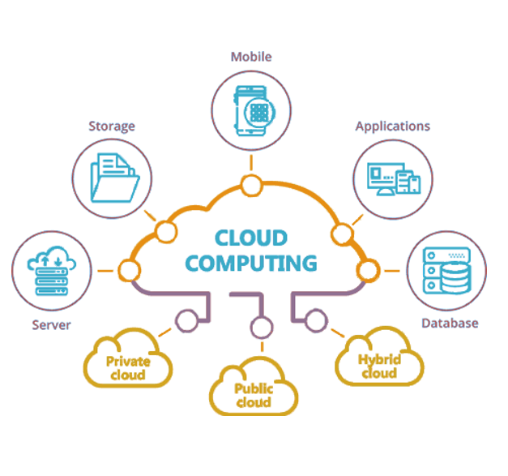
Cloud Computing
Notes:
https://images.app.goo.gl/cUQsvH74F3Qdkawf8

Slide 21
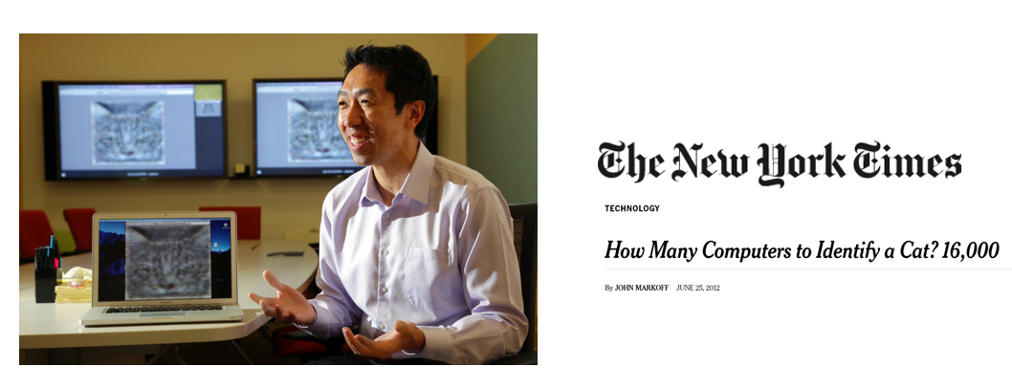
Look Mom! I found a Cat!

Slide 22
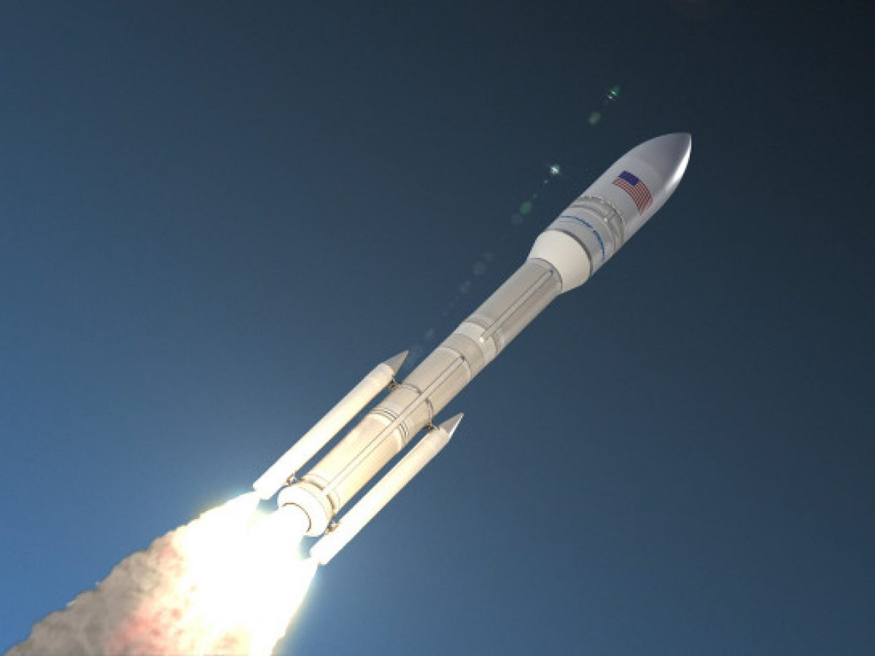
Why AI now? Advances in Big Data
Advances in algorithm
Advances in computing power
Advances in Big Data
Data is the new oil!

Slide 23
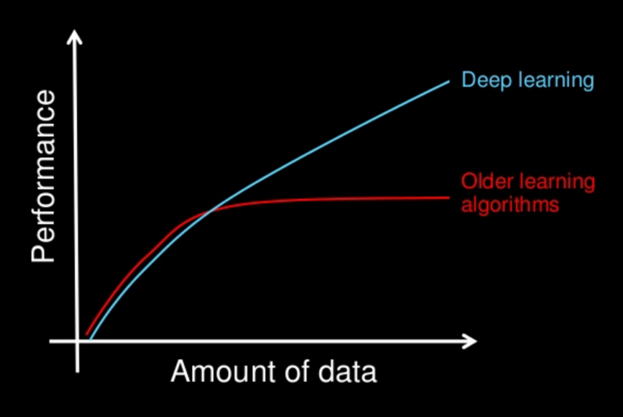
Deep Learning

Slide 24
Tipping point?
“Most people don’t understand the difference between 95% accuracy and 99% accuracy.
99% is game changing.”
Andrew Ng

Slide 25
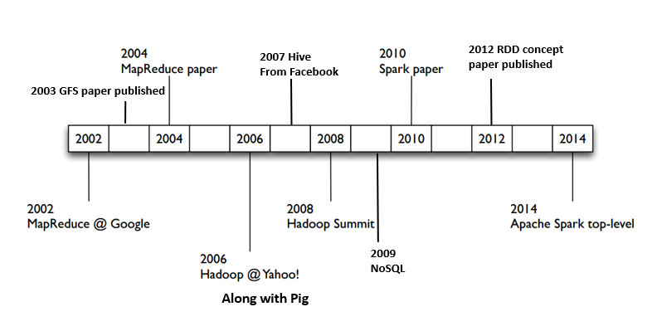
Big Data Timeline

Slide 26
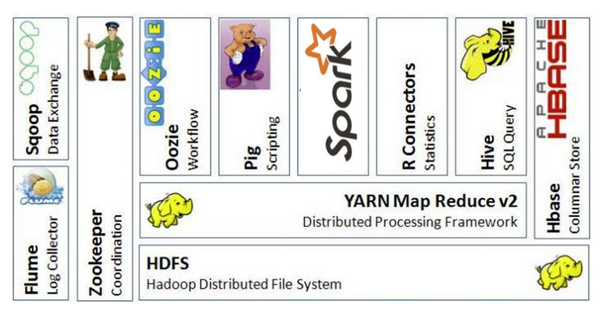
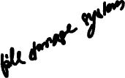
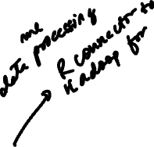









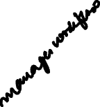
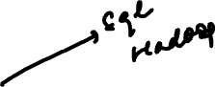
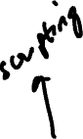
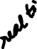
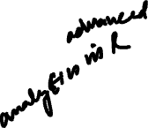
Here comes Big Data!

Slide 27
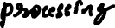
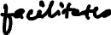
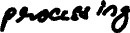
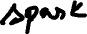




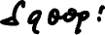


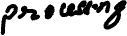







Slide 28





















Slide 29

Deep Learning

Slide 30
Deep Learning
Algorithm
AI
Computing
Big Data

Slide 31

“People should stop training radiologists now. It’s just completely obvious that within 5 years, deep learning is going to do better than radiologists […] We’ve got plenty of radiologists already [.]”
- Geoffrey Hinton (2016)

Slide 32

Key tension: Experience / Human Capital
“[a] highly-trained and specialised radiologist may now be in greater danger of being replaced by a machine than his own executive assistant”
-Andrew Ng (2016)
Notes:
Morgenstern M (2017) Automation and anxiety. The Economist https://www.economist.com/special-report/2016/06/25/automation-and-anxiety. Accessed 7 Aug 2017

Slide 33
AWS CEO reading (on Canvas)

